Slide 1

Parallel and Distributed Computing
Communications

Slide 2
Distributed Systems
(3rd Edition)
Chapter 04: Communication
Version: February 25, 2017
Revised: Oct 2021

Slide 3
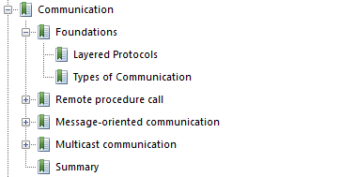
Chapter 4- Communications

Slide 4
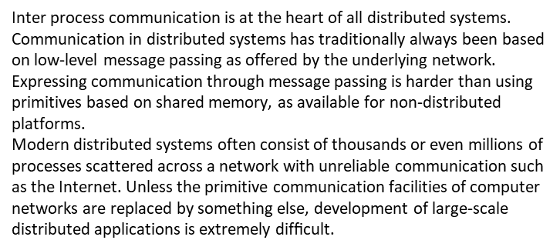
Overview
Communication: Foundations Layered Protocols
The OSI reference model
4 / 49

Slide 5
Layered protocols
Communication: Foundations Layered Protocols
When process P wants to communicate with process Q, it ﬁrst builds a message in its own address space. Then it executes a system call that causes the operating system to send the message over the network to Q.
Although this basic idea sounds simple enough, in order to prevent chaos, P and Q have to agree on the meaning of the bits being sent.
The OSI reference model
5 / 49

Slide 6
Basic networking model- OSI Ref Model
Communication: Foundations Layered Protocols
Application
Application protocol
7
Presentation
Presentation protocol
6
Session
Session protocol
5
Transport
Transport protocol
4
Network protocol
3
Network
Data link protocol
2
Data link
Physical
Physical protocol
1
Network
Drawbacks
Focus on message-passing only
Often unneeded or unwanted functionality Violates access transparency
The OSI reference model
6 / 49

Slide 7
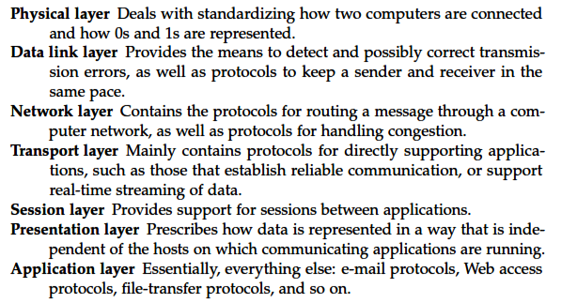
Layers

Slide 8
Low-level layers
Communication: Foundations Layered Protocols
Recap
Physical layer: contains the specification and implementation of bits, and their transmission between sender and receiver
Data link layer: prescribes the transmission of a series of bits into a frame to allow for error and flow control
Network layer: describes how packets in a network of computers are to be
routed.
Observation
For many distributed systems, the lowest-level interface is that of the network layer.
The OSI reference model
8 / 49

Slide 9
Transport Layer
Communication: Foundations Layered Protocols
Important
The transport layer provides the actual communication facilities for most distributed systems.
Standard Internet protocols
TCP: connection-oriented, reliable, stream-oriented communication UDP: unreliable (best-effort) datagram communication
Many other protocols are in use like
Real time Transport protocol
Streaming Control Transmission Protocol etc.
The OSI reference model
9 / 49
Notes:
Additional transport protocols are regularly proposed. For example, to support
real-time data transfer, the Real-time Transport Protocol (RTP) has been
deﬁned. RTP is a framework protocol in the sense that it speciﬁes packet formats
for real-time data without providing the actual mechanisms for guaranteeing
data delivery. In addition, it speciﬁes a protocol for monitoring and controlling
data transfer of RTP packets [Schulzrinne et al., 2003]. Likewise, the Streaming
Control Transmission Protocol (SCTP) has been proposed as an alternative to
TCP [Stewart, 2007]. The main difference between SCTP and TCP is that SCTP
groups data into messages, whereas TCP merely moves bytes between processes.
Doing so may simplify application development.

Slide 10
OS and Middleware
Operating System: Serves as a bridge between the hardware and applications. It manages hardware resources, provides essential services, and enables applications to run.
Middleware:
Exists between the operating system and the application layer, providing additional functionality to enable communication and data management in distributed systems.

Slide 11
Middleware protocols
The middleware protocol provides higher level service to application which is even much more advanced than session and presentation layer.
For example, Multicast, Broadcast, Unicast services are provided by the middleware.
Application just needs to send a packet for broadcast to the middleware and then Middleware takes care of sending the message to the network.
Essentially middleware abstracts the Application from the TCP / IP and other networking aspects of the distributed system.

Slide 12
Client server TCP connection- 3 way handshaking
In a typical client server architecture, client constructs a request and sends it over to the server, server processes the request at its end and sends back the response to the client.
For a client to send a message to the server, the client has to establish a TCP connection to the server first, i.e. a 3-way handshake is required.
The client sends a SYN packet to the server, which means that the client wants to establish a TCP connection with the server.
Server in turn sends back a SYN and a ACK(SYN) packet back to the client.
ACK(SYN) is the acknowledgement sent from the server to the client.
The client then acknowledges the SYN request of server by sending a ACK message back to the server.
Thus this is a 3-way handshake mechanism to establish a TCP connection.

Slide 13
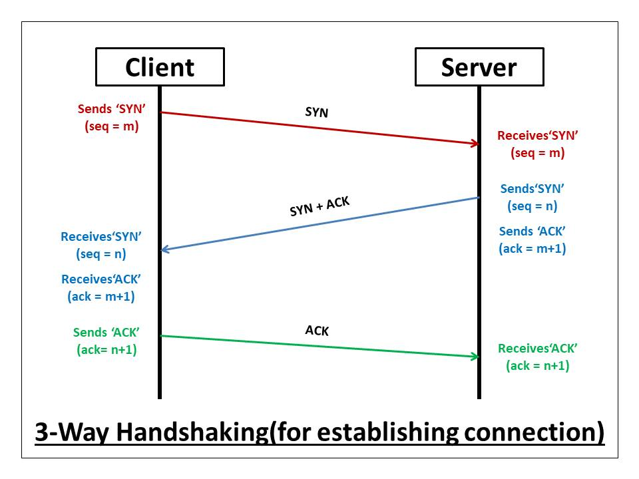
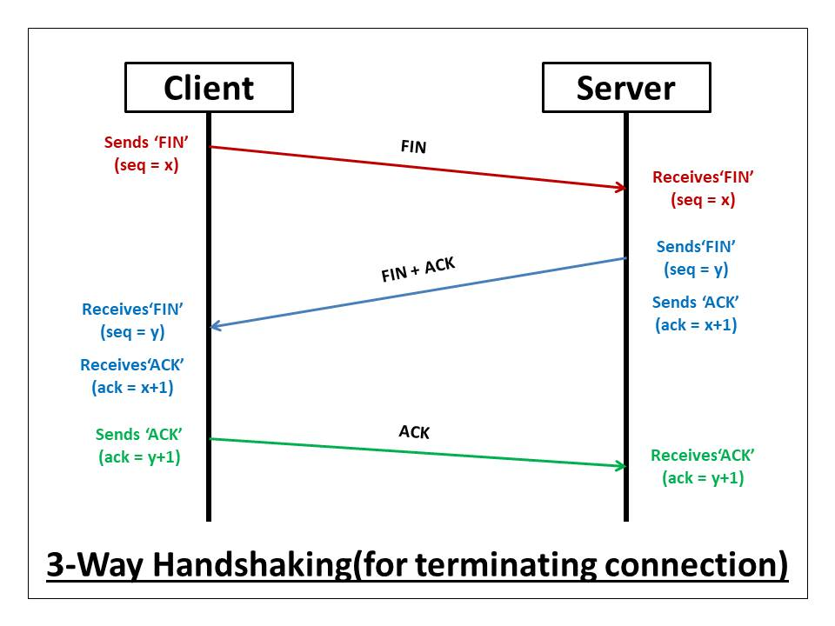
Client server TCP connection

Slide 14
Push or Pull Architecture
Client - Pull Architecture:
The client sends in request to the server to pull data from it.
For example, HTTP is a client pull architecture protocol where a client sends a webpage request to get a reply from the web server.
Pros:
In this type of architecture the servers are stateless , i.e. servers don't need to keep track of the clients its communicating with.
From a failure prospective this architecture is more robust since no state of clients is maintained, thus if the server crashes, the client just needs to send a new request for the data.
Cons:
This architecture is more scalable from memory point of view since states of client need not be maintained on the server. But this architecture is not efficient from communications point of view.
To get one piece of data two messages are exchanged i.e. a request and a reply, which results in a overhead.

Slide 15
Push or Pull Architecture
Server - Push Architecture:
In this architecture, the client may not send explicit requests for data, server asynchronously pushes data to the client.
For example, in Video and Audio Streaming, the client just sends a one time request for the data on the server, after that the server starts pushing data. The client just listens to the socket and data keeps coming in from the server.
Cons:
In this type of architecture the servers are stateful, i.e. the servers keep tracks of the clients its communicating with.
This architecture is not robust from failure point of view. If the server reboots, then all the state of clients is lost from memory
Pros:
This architecture is less scalable from memory point of view since states of clients needs to be maintained in the servers memory. But from communication point of view this architecture is more efficient,
since client just sends in one request and server starts pushing data to the client which has less overhead than client - pull architecture.

Slide 16
Middleware Role in Distributed Systems
Middleware acts as a software layer that sits between the operating system and applications in a distributed system. Its primary purpose is to enable seamless communication, coordination, and resource sharing among distributed components
Middleware is invented to provide common services and protocols that can be used by many different applications
A rich set of communication protocols
(Un)marshaling of data, necessary for integrated systems
Naming protocols, to allow easy sharing of resources Security protocols for secure communication
Scaling mechanisms, such as for replication and caching

Slide 17
An adapted layering scheme
Communication: Foundations Layered Protocols
Application protocol
Application
Middleware
Middleware protocol
Operating system
Host-to-host protocol
Physical/Link-level protocol
Hardware
Network
Middleware protocols
17 / 49

Slide 18
Types of communication
Communication: Foundations Types of Communication
Viewing middleware as an distributed service in application-level communication
Synchronize at request submission
Client
Synchronize at request delivery
Synchronize after processing by server
Request
Transmission interrupt
Storage facility
Reply
Server
Time
Transient versus persistent communication
Asynchronous versus synchronous communication
18 / 49

Slide 19
Types of communication
Communication: Foundations Types of Communication
Viewing middleware as an distributed service in application-level communication
With persistent communication, a message that has been submitted for transmission is stored by the communication middleware as long as it takes to deliver it to the receiver.
In this case, the middleware will store the message at one or several of the storage facilities
with transient communication, a message is stored by the communication system only as long as the sending and receiving application are executing.
More precisely, if the middleware cannot deliver a message due to a transmission interrupt, or because the recipient is currently not active, it will simply be discarded.
19 / 49

Slide 20
Types of communication
Communication: Foundations Types of Communication
Viewing middleware as an distributed service in application-level communication
The characteristic feature of asynchronous communication
is that a sender continues immediately after it has submitted its message for transmission. This means that the message is (temporarily) stored immediately by the middleware upon submission.
With synchronous communication, the sender is blocked until its request is known to be accepted.
20 / 49

Slide 21
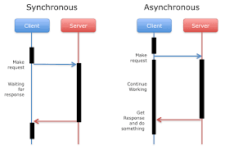
Sync Vs Async

Slide 22
Messaging
Communication: Foundations Types of Communication
Message-oriented middleware
Aims at high-level persistent asynchronous communication:
Processes send each other messages, which are queued Sender need not wait for immediate reply, but can do other things Middleware often ensures fault tolerance

Slide 23
In parallel and distributed computing, large computational tasks are divided into smaller parts and executed simultaneously using multiple processors or computers. The Python library mpi4py provides an interface to the Message Passing Interface (MPI), which allows different processes to communicate with each other. Using mpi4py, a program can run on multiple processes where each process performs part of the computation and exchanges data when needed. This approach improves performance, reduces execution time, and enables efficient use of distributed systems such as clusters and supercomputers.

Slide 24
from mpi4py import MPI
# Initialize communicator
comm = MPI.COMM_WORLD
# Get process rank (ID)
rank = comm.Get_rank()
# Get total number of processes
size = comm.Get_size()
print("Hello from process", rank, "out of", size)

